Slide 1

Live, Laugh, Signal
An in-depth look into Angular Signals
Dan Klingmann, Staff Software Engineer, Celonis
3rd December, 2025

Slide 2

About me
Daniel “Dan” Klingmann
Obsessed about Frontend Architecture & Performance
Working in frontend since the double float margin bug was a thing (that’s 2001).
Hobbies include composing music in my home studio, gaming or working on an MMO quiz game show.

Slide 3
Where we’re coming from > Reactivity before Signals
Promises
Proxies (Vue for example)
EventEmitters
RxJS Observables
One problem though…

Slide 4
They’re not well suited for state

Slide 5
Workarounds for state
State management libraries centered around redux
ngrx
ngxs
Other state management libraries
Or DIY solutions with services

Slide 6
Signals:
A new* reactive primitive
* Calling Angular v17 new is a stretch but chances are you’re working on enterprise software so you’re probably stuck with ancient versions of Angular anyways so it might indeed be new for you. Surely you’ve already convinced management you need to migrate away from AngularJS by now, right? What do you mean you’re still using JQuery?

Slide 7
What’s the hype about signals?
Signals are lazily evaluated (unless they’re live)
Computed signals are memoized
They’re highly performant
They come included with Angular
They use the Angular Injection Context and thus can be garbage collected automatically (because we all sometimes forget to unsubscribe, right?)
Oh and…

Slide 8
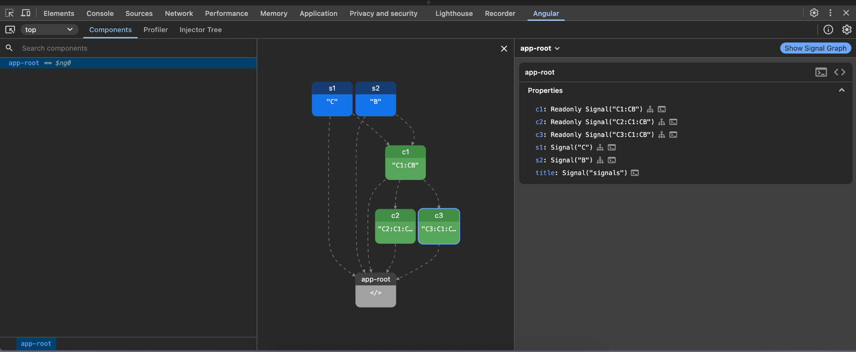
FREAKING
AWESOME
DEVTOOLS

Slide 9
Types of Signals > signal / WritableSignal
function signal<T>( initialValue: T ): WritableSignal<T>
Initial value
Can be written to hence returning a WritableSignal
Can be changed via set(newValue)
Can be derived via update(oldValue => oldValue + myChange)
Similar to the RxJS BehaviorSubject
Notes:
Distinguish between WritableSignal and Signal. Also that all signals can be passed an additional object containing an equality function and a debugName. In the end, set and update both call the same function

Slide 10
Types of Signals > signal / Signal
signalFn.asReadonly = signalAsReadonlyFn.bind(signalFn)
function signalAsReadonlyFn<T>( this: SignalGetter<T> ): Signal<T>
Can be called as signal.asReadonly
Depends on the existing signal
Can NOT be written to hence only returning a Signal
Similar to the RxJS Subject.asObservable()

Slide 11
Types of Signals > computed / Signal
function computed<T>( computation: () => T ): Signal<T>
Runs a given computation lazily when accessed
Can not be written to
Similar to RxJS combineLatest with a mapping function

Slide 12
Types of Signals > linkedSignal / WritableSignal
function linkedSignal<T>({
source: () => S;
computation: ComputationFn<S, D>;
}): WritableSignal<D>
Runs a given computation every time the source signal changes
Can actually be written to as it’s a WritableSignal
Similar to RxJS switchMap with a mapping function

Slide 13
Omissions
HttpResource - Allows you to call an HTTP endpoint on change of a signal with complete control over the request (methods, payload, headers)
Resource - Similar, but works with any arbitrary async function
Effect - Kind of the basis for the other above, run any code when something changes.

Slide 14
But how does that work in Angular?
Disclaimer: This is all taken from source code and interpreted by the author. The intention is to give an overview of the things Angular does to provide you with some basic understanding of how it works. The signal implementation of Angular is very well documented and I hope to pique your interest enough to take a look at the implementation yourself.

Slide 15
It’s a reactive graph. That’s it.
Thanks for joining my talk. Enjoy the food and drinks.

Slide 16
Reactive Nodes
ALL reactive nodes are created via Object.create and inherit from the REACTIVE_NODE^{[1]} object implementing the ReactiveNode interface^{[2]}.
They then selectively override some of the properties.
const REACTIVE_NODE: ReactiveNode = {
version: 0 as Version,
lastCleanEpoch: 0 as Version,
dirty: false,
producers: undefined,
producersTail: undefined,
consumers: undefined,
consumersTail: undefined,
recomputing: false,
consumerAllowSignalWrites: false,
consumerIsAlwaysLive: false,
kind: 'unknown',
producerMustRecompute: () => false,
producerRecomputeValue: () => {},
consumerMarkedDirty: () => {},
consumerOnSignalRead: () => {},
};
[1] https://github.com/angular/angular/blob/f35b2ef47cef778e35c3f62ba51212b3585a33f2/packages/core/primitives/signals/src/graph.ts#L64 [2] https://github.com/angular/angular/blob/f35b2ef47cef778e35c3f62ba51212b3585a33f2/packages/core/primitives/signals/src/graph.ts#L112

Slide 17
Angular splits signals into two roles
Producers
Hold values that can be updated at any time.
signal
computed
linkedSignal
resource
Consumers
Read the values that are stored in producers.
effects
computed
linkedSignal
resource
template
Notes:
Mention that some signals are both producer and consumer

Slide 18
Graph structure
Signals can be both, producer AND consumer.
A
B
C
Signals on a graph that are not an end are producers.
AB
Signals on a graph that are not at the beginning are consumers.
ABC
(Computeds at the end theoretically also produce values that are probably consumed by a template)
Signal Computed

Slide 19
How does Angular know what needs to be updated?

Slide 20
Dependency tracking
Signals track dependencies in a linked list of producers using the ReactiveLink^{[1]} interface
On accessing a signal, it is checked if the access was coming from a reactive context^{[2]}.
Reactive context means, a consumer has set itself as active consumer.
interface ReactiveLink {
producer: ReactiveNode;
consumer: ReactiveNode;
lastReadVersion: number;
prevConsumer?: ReactiveLink;
nextConsumer?: ReactiveLink;
nextProducer?: ReactiveLink;
}
[1] https://github.com/angular/angular/blob/f35b2ef47cef778e35c3f62ba51212b3585a33f2/packages/core/primitives/signals/src/graph.ts#L82 [2] https://github.com/angular/angular/blob/f35b2ef47cef778e35c3f62ba51212b3585a33f2/packages/core/primitives/signals/src/graph.ts#L213

Slide 21
Dependency tracking - Example
S1:1
S2:1
S1 and S2 are simple signals holding a string character
C1 is a computed signal: () => s1() + s2()
As C1 was not read yet, it doesn’t have a value and no recorded dependencies.
A
B
C1:?
?
Active Consumer: -
Dependencies: -
Signal Computed

Slide 22
Dependency tracking - Example
S1:1
S2:1
Calling C1 now does the following (although quite a bit simplified):
A
B
Set itself as active consumer
Run the computation fn
C1:1
AB
?
First call S1 adding the first dependency
Then call S2 adding the second dependency
Active Consumer:
Dependencies:
C1
S1 (lastReadVersion: 1)
Store and return the value
S2 (lastReadVersion: 1)
Signal Computed

Slide 23
Dependency tracking - Example
S1:1
S1:2
S2:1
Changing the value of S1 now leads to the following:
A
C
B
Increase it’s own version
Increase the epoch* counter
C1:1
AB
Update it’s value
S1 does not know of C1 so it can’t force an update.
Active Consumer:
Dependencies:
Signal Computed
*Well come back to epochs later

Slide 24
Dependency tracking - Example
S1:2
S2:1
Reading C1 now does the following
C
B
Check lastRead versions against the dependencies
C1:1
C1:2
AB
See that S1:1 and S1:2 don’t match so get new value and run computation again.
CB
Store new lastReadVersion
Active Consumer:
Dependencies:
C1
Increase own version
S1 (lastReadVersion: 1)
S1 (lastReadVersion: 2)
S2 (lastReadVersion: 1)
Set new value
Signal Computed

Slide 25
Dependency tracking - Example
S1:1
S2:1
What if we have another computed C2 depending on C1?
Let’s access C2 and see what happens.
A
B
C1:1
C2:1
?
?
Active Consumer:
Dependencies:
Signal Computed

Slide 26
Dependency tracking - Example
S1:1
S2:1
First off, C2 sets itself as active consumer and calls C1.
However, C1 itself does not have a value yet.
A
B
C1:1
C2:1
?
?
Active Consumer:
Dependencies:
C2
Signal Computed

Slide 27
Dependency tracking - Example
S1:1
S2:1
C1 thus sets itself as active consumer
A
B
It then runs its computation first and accesses S1 and S2 storing it as dependencies and setting its value.
C1:1
C2:1
?
AB
?
After it completes, it sets the previous consumer back as active consumer
Active Consumer:
Dependencies:
C1
C2
S1 (lastReadVersion: 1)
S2 (lastReadVersion: 1)
Signal Computed

Slide 28
Dependency tracking - Example
S1:1
S2:1
C2 can now get the value from C1 and sets it as dependency.
Let’s change a signal’s value now again.
A
B
C1:1
C2:1
AB
AB
Active Consumer:
Dependencies:
C2
C1 (lastReadVersion: 1)
Signal Computed

Slide 29
Dependency tracking - Example
S1:2
S2:1
We change S1 to have a new version and now access C2 again.
However, just checking for the version now doesn’t work.
Angular first checks the version, then runs the update on the producer and then runs the check again.^{[1]}
But what if two computed Signals depend on a large calculation?
C
B
C1:2
C2:2
CB
CB
Active Consumer: C2
Dependencies:
C1 (lastSeen 1)
Signal Computed
[1] https://github.com/angular/angular/blob/e26aa86aa54a1fcd58869296660633c66898fc94/packages/core/primitives/signals/src/graph.ts#L456

Slide 30
Dependency tracking - Example
C1:1
In this example, the computed C1 is a particularly heavy calculation which has C2 and C3 as dependents.
Based on the previous example, you would expect C1 to run multiple times as it might be stale leading to expensive recalculations.
That is, unless we track that “somehow”.
?
C2:1
C3:1
?
?

Slide 31

Introducing:
Epochs
Big fan of the gothic epoch but I digress.
It’s awesome though, JUST LOOK AT THIS ->

Slide 32
Epochs
function signalValueChanged(node) {
node.version++;
producerIncrementEpoch();
producerNotifyConsumers(node);
postSignalSetFn?.(node);
}
When a signal’s value is changed^{[1]}, it
Increases its own version
Increases the global epoch
Notifies any live consumers of the change
producerIncrementEpoch is literally just epoch++
Let’s see how the epoch counter helps against recalculations.
[1] https://github.com/angular/angular/blob/f35b2ef47cef778e35c3f62ba51212b3585a33f2/packages/core/primitives/signals/src/signal.ts#L121

Slide 33
Epochs
… if ( !node.dirty &&
node.lastCleanEpoch === epoch ) {
return;
}
… node.producerRecomputeValue(node) producerMarkClean(node);
Producers will always call producerUpdateValueVersion when it is requested to update its own value.
One of the checks is for the lastCleanEpoch. If it’s not equal, it will run the computation again.
The last call simply sets the node’s dirty flag to false and the lastCleanEpoch to the current so calculations in the same epoch are guaranteed to have the up-to-date value.

Slide 34
Epochs - Example
Epoch: 1
C1:1
Let’s assume we are at epoch 1.
C2 calls C1 and requests an update.
->C1 doesn’t have a value yet
C1 calculates a value and sets its last clean epoch to 1 and returns the value to C2 which also sets its last clean epoch.
AB
lCE: 1
C2:1
C3:1
AB
?
lCE: 1

Slide 35
Epochs - Example
Epoch: 1
C1:1
Now C3 also is called and requests the value from C1.
C1 now checks if the epoch changed.
As it didn’t, its value is guaranteed to be up-to-date and no computations need to run.
C3 is now also at epoch 1.
AB
lCE: 1
C2:1
C3:1
AB
AB
lCE: 1
lCE: 1

Slide 36
Epochs - Example
Epoch: 2
C1:2
Let’s change an upstream Signal. This will set the epoch to 2.
Accessing C3 will now see that the epoch changed and ask it’s dependency to update.
C1 checks the lastSeenVersions of its own dependencies and then update accordingly.
No matter if it had to update or not, the last clean epoch is set again and the new value returned to C3.
CB
lCE: 2
C2:1
C3:2
AB
CB
lCE: 1
lCE: 2
Notes:
Highlight how you’d still have the stale value in C2 bringing you to the next topic.

Slide 37
How does this actually work in templates?

Slide 38
Live Signals
Signals like template, effect or resource are live.
Not really lazily evaluated as they’re not actively called by the user
Update via Push/Pull principle to prevent glitches^{[1]}
Push a dirty value in a notification phase to all tracked consumers
Consumers then pull the new values evaluating all dependencies
Wait a second…
tracked consumers?
[1] https://github.com/angular/angular/blob/main/packages/core/primitives/signals/README.md#pushpull-algorithm

Slide 39
Live Signals - Tracking consumers
A signal that’s live will ALWAYS result in all its dependencies being treated as live signals so it can receive updates.
For this, producers NEED to know who depends on them thus tracking them in the consumers linked list.
If a producers with such a dependents value changes, it will mark all live dependents dirty recursively and calls consumerMarkedDirty^{[1]} on them.
[1] https://github.com/angular/angular/blob/a0ad5d4b2b2a99fb8eee2003393f85c7824c7b72/packages/core/primitives/signals/src/graph.ts#L359

Slide 40
Signals in templates
Special ReactiveLViewConsumer type (basically a big computed)
Attached to the LView of a component
Is always live
Consumes all signals called in the template
Schedules a change detection cycle on consumerMarkedDirty
Change detection cycle checks if the consumer is marked dirty and if it is, rerenders the template

Slide 41
Template - Initial value example
A
S1
Template sets itself as active consumer and executes (as before)
Calls C1 which realizes the consumer is live and adds it as dependency to consumer.
C1 recalculates and thus calls S1
S1 realizes C1 is transitively live and stores it as consumer.
C1
A
dirty: false
Template
dirty: false

Slide 42
Template - Update example
B
S1
We now update the value S1
S1 sees live consumers and enters a notification phase, iterating through consumers and marking them dirty.
C1 gets the notification and recursively marks the template dirty
The template’s consumerMarkedDirty function schedules a new change detection cycle.
Normal update happens
C1
A
dirty: true
Template
dirty: true
Notes:
While this has just shown how it works for the template, it works almost exactly the same for effect and other live signals.

Slide 43
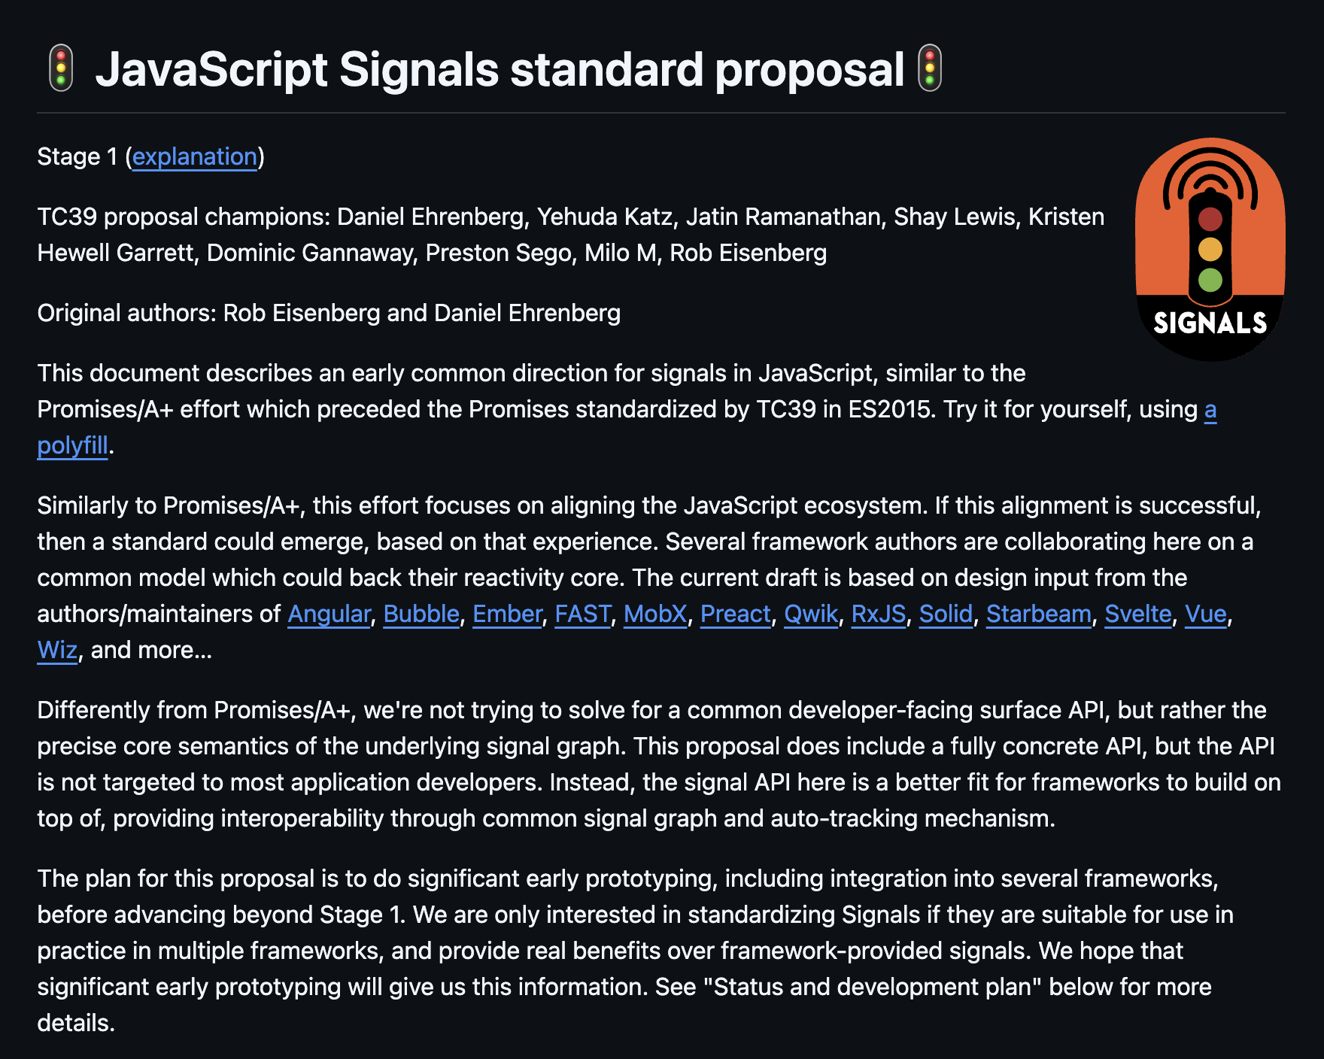
Where we’re going to (hopefully)
Signals are already a proposed standard^{[1]} albeit currently in draft “The current draft is based on design input from the authors/maintainers of Angular, Bubble, Ember, FAST, MobX, Preact, Qwik, RxJS, Solid, Starbeam, Svelte, Vue, Wiz, and more…”
One can hope.
[1] https://github.com/tc39/proposal-signals

Slide 44
Outlook on Signal forms^{[1]}
A new way to create reactive forms introduced recently.
Allows you to define your form state in a signal in an easy way including validation.
Available with Angular v21^{[2]}
// TS interface LoginData {
email: string;
password: string;
}
const loginModel = signal<LoginData>({
email: '',
password: '',
});
const loginForm = form(loginModel); // HTML <input type="text" [field]="loginForm.name" />
<input type="email" [field]="loginForm.email" />
[1] https://angular.dev/essentials/signal-forms [2] https://blog.angular.dev/announcing-angular-v21-57946c34f14b

Slide 45
If you want to dive in yourself…
Most of the reactive code can be found in /packages/core/primitives/signals
Wrappers for common usage of signals are in /packages/core/src/render3/reactivity
If you’re brave enough and see a use-case, you could even implement your own custom signals on top of this.
For example, why not try something with WebSockets?

Slide 46
Q&A

Slide 47
Thank you.

